Slide 1
NODE.JS
(The Backend Of MERN Stack)
Lecture 16

Slide 2
Today’s Agenda
What is Express?
What is a Framework ?
Opinionated V/s Unopinionated
History of Express
Installing Express
Creating first Express server
Sending response
Sending headers & status

Slide 3
What is express ?
"Express or Express.js is a fast, unopinionated and minimalist web framework for Node.js" - official web site: Expressjs.com
In simple words we can say that Express.js is a web application framework for Node.js that provides various features to make web application development fast and easy which otherwise takes more time using only Node.js.

Slide 4
What is a framework ?
Frameworks are powerful tools that can make a developer’s job easier.
They provide a standardized set of design and development conventions that can be applied and modified for our web application.

Slide 5
What does a framework do ?
If we look at any multiple web applications we can see that there are some common features like:
Routing
User authentication
Connect to databases
Rendering pages etc

Slide 6
What does a framework do ?
Now , we can write all the above logic ourself but it will be simply waste of time .
So to help a developer to eliminate the need to write a lot of repetitive code, there are lot of tools available which can do that for us.
And they are called Framework.

Slide 7
Opinionated v/s unopinionated
To understand unopinionated , we must first understand the word opinionated .
An "opinionated framework" is a software framework that provides a set of guidelines and conventions called design patterns that developers are expected to follow, rather than leaving all decisions up to the developer.

Slide 8
Opinionated v/s unopinionated
This can make development more efficient, but it can also make it more difficult to use the framework in ways that deviate from the intended use.
Examples of opinionated frameworks are:
Django
Angular
Ruby On Rails
Laravel

Slide 9
Opinionated v/s unopinionated
An unopinionated framework, also known as a "loosely-coupled" framework, is a software framework that provides a lot of flexibility and doesn't make many assumptions about how the software should be structured and used.
Examples of unopinionated frameworks are:
Express
Flask
Spring

Slide 10
How is express unopinionated ?
Unlike other frameworks like Laravel, the Express.js framework doesn’t apply any prevalent design patterns such as MVC, MVP, MVVM, etc .
Rather it is built with simplicity, easy to use in mind.
With Express.js , we can customize and roll out our own application structure without having to follow a particular pattern or folder structure.

Slide 11
History of express
Express was developed by TJ Holowaychuk and the first release occurred on May 22, 2010.
In June 2014, a company called StrongLoop acquired the rights to manage it.

Slide 12
History of express
Then in September 2015, IBM acquired StrongLoop
Later, in January 2016, IBM announced that it would place Express under the control of the NodeJS Foundation incubator.
As of now , its latest version is 4.18.2 .

Slide 13
What express js can do ?
Express Js helps a backend developer to perform following tasks:
Creating web server
Handling Routing
Developing API
Working With MiddleWare & Template Engines
Connect To The Databases

Slide 14
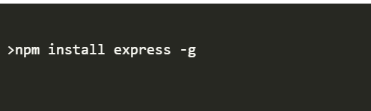
Installng express
We can install express in the following ways :
Installing express globally : We can install express with global scope in the following way:

Slide 15
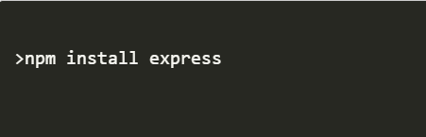
Installng express
Installing express locally : We can install express with local scope in the following way

Slide 16
Developing first express server
To create a web server using Express we need to take 4 steps:
Import the express module which will return a function.
Call that function to get an object which can be used to configure our server.
Using that server object call the method get() passing it 2 arguments : a route and a callback with 2 arguments called req and resp.
Finally start the server and wait for the client request by calling the server object method listen() passing it the required port number and a callback

Slide 17
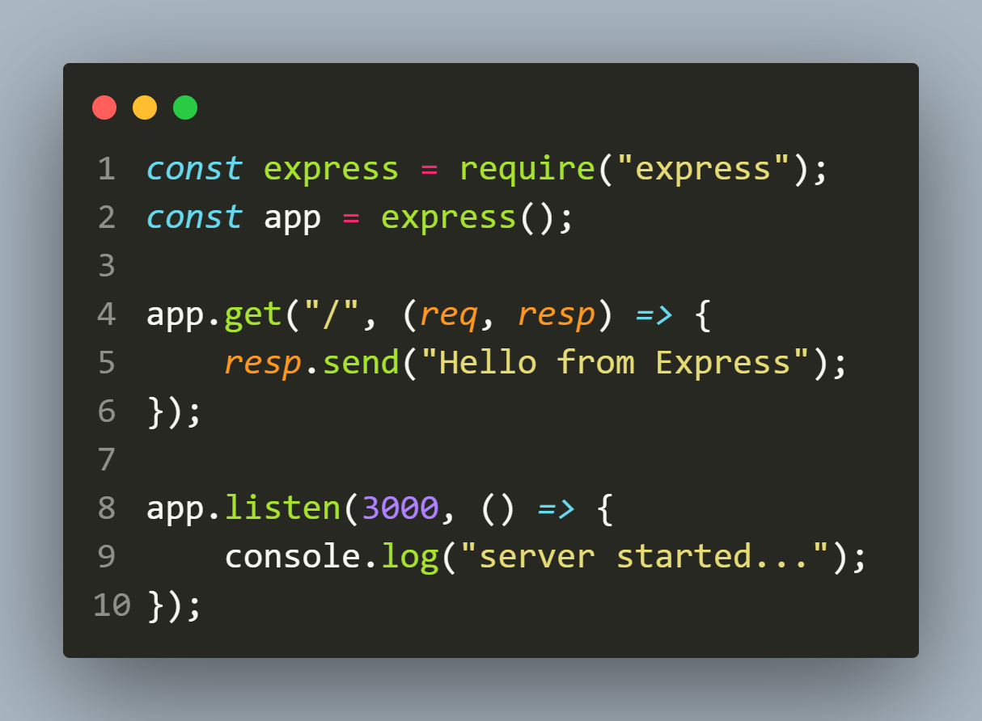

example
The code
The output

Slide 18
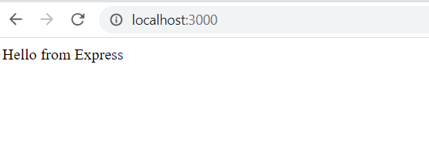
Sending request
Now open the browser and send the request to http://ocalhost:3000.

Slide 19
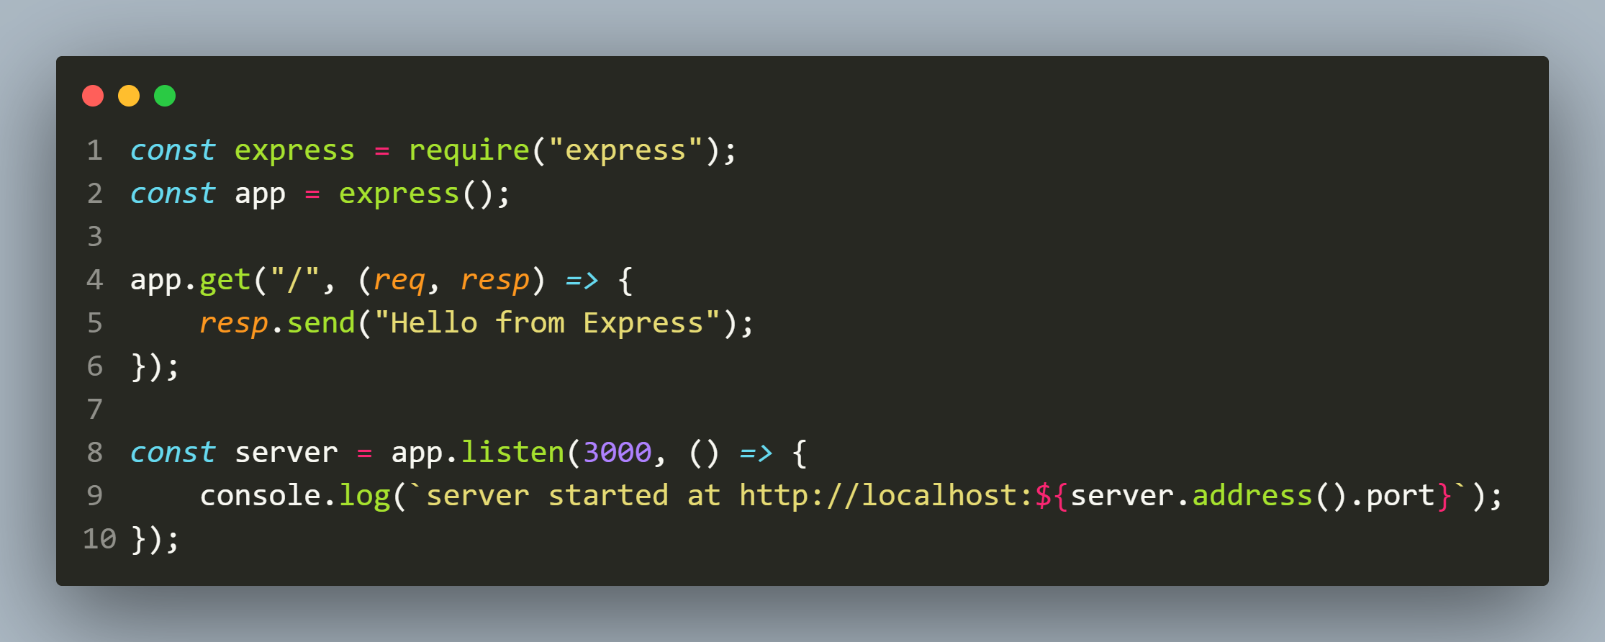

Printing server’s port
The code
The output

Slide 20
The power of send() method
The send() method of response object is a very powerful method as it does 3 tasks automatically:
Sets the content-type
Sends the response
Closes the connection

Slide 21
How it sets the content-type ?
Answer: By looking at our response data
If we pass in a string, it sets the Content-Type header to text/html.
If we pass in an object or an array, it sets the Content-Type header to application/json and parses that parameter into JSON.

Slide 22
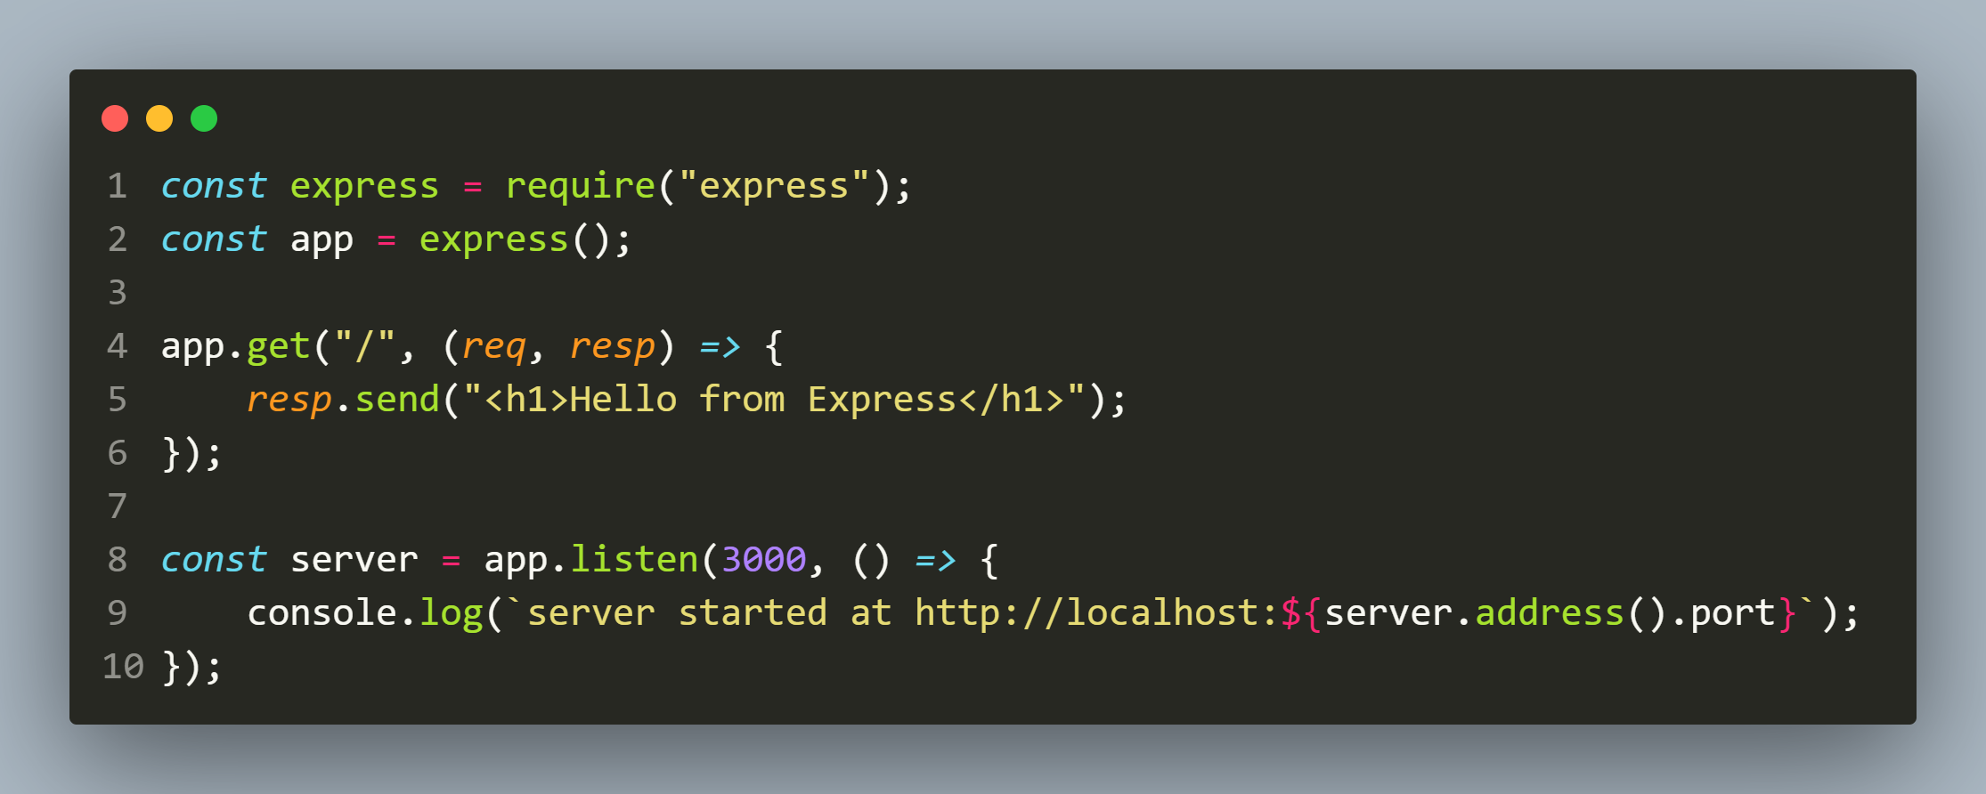
Example( sending html )
The code

Slide 23
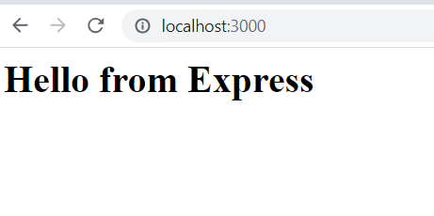
output
The output

Slide 24
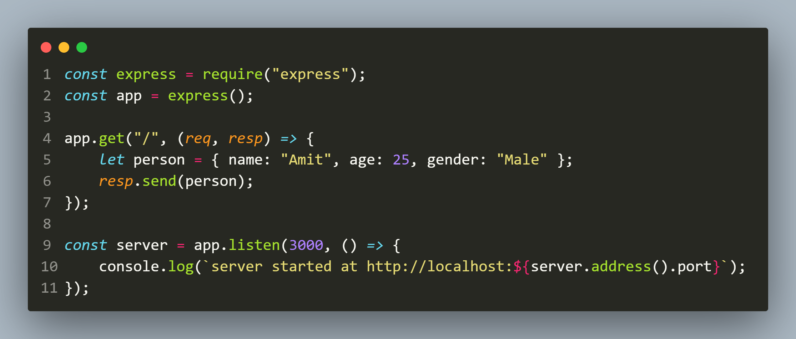
Example( sending json )
The code

Slide 25
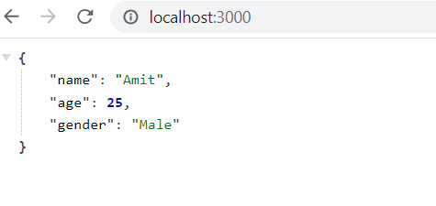
output
The output

Slide 26
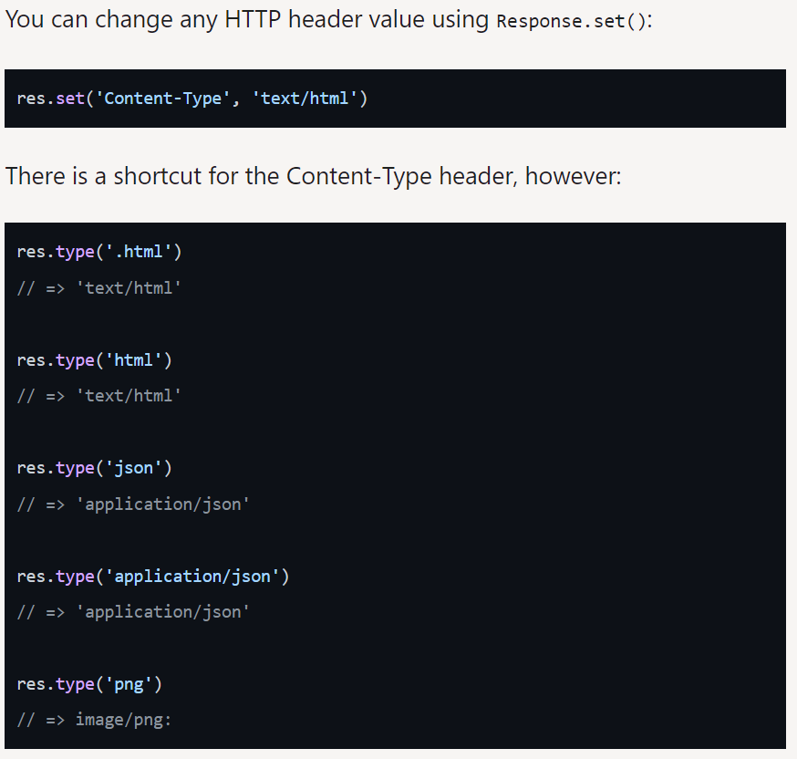
Changing http header value

Slide 27
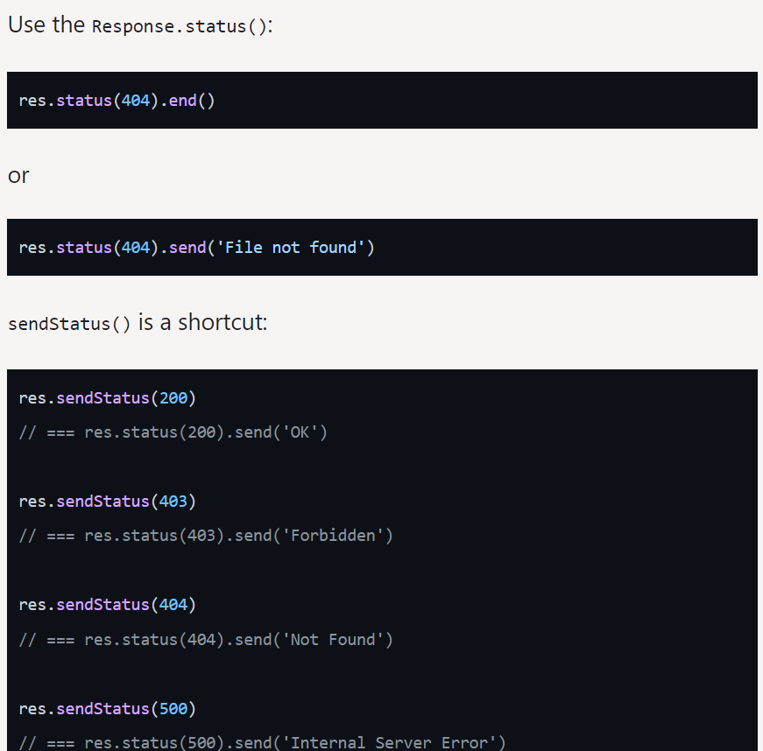
Sending response status

